Slide 1

Chapter 10 Part 2
Transaction Management and
Concurrency Control
The slides in this presentation have been adapted from slides provided with the textbook, Database Systems: Design, Implementation, and Management,
12E, Cornel and Morris, Copyright © 2017 Cengage Learning.

Slide 2
Learning Objectives
What concurrency control is and what role it plays in maintaining the database’s integrity
Copyright © 2017 Cengage Learning
2

Slide 3
Concurrency Control
Coordination of the simultaneous transactions execution in a multiuser database system
Objective - Ensures serializability of transactions in a multiuser database environment
Copyright © 2017 Cengage Learning
3

Slide 4
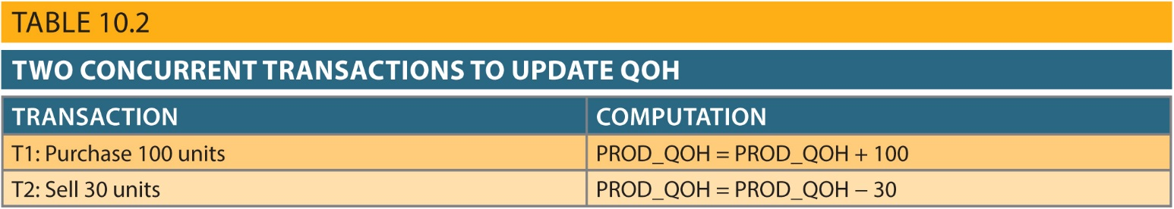
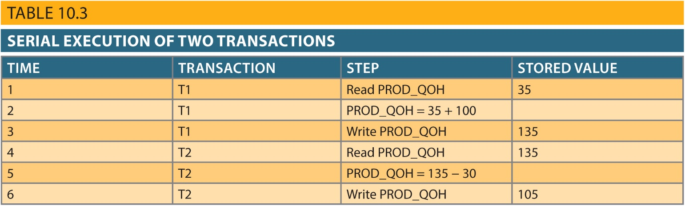
Concurrent Transactions
Copyright © 2017 Cengage Learning
4

Slide 5
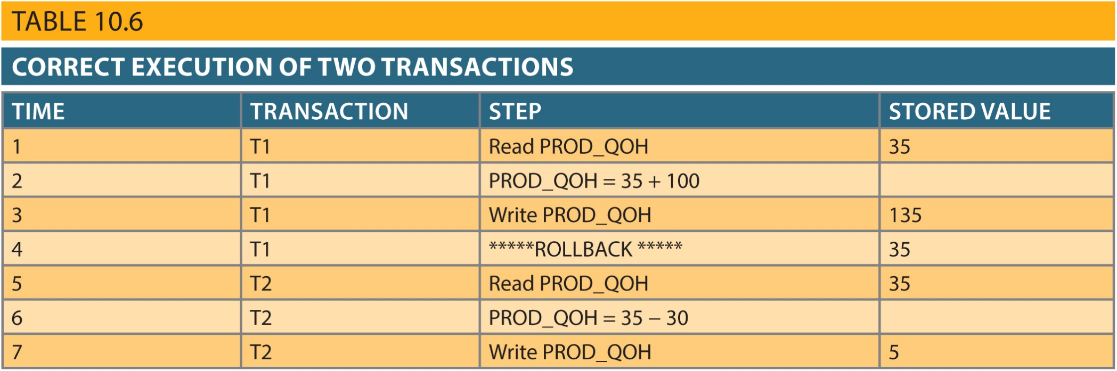
Rolling Back a Transaction
Copyright © 2017 Cengage Learning
5

Slide 6
Problems in Concurrency Control
Lost update
Uncommitted data
Occurs when:
Two transactions are executed concurrently
First transaction is rolled back after the second transaction has already accessed uncommitted data
Inconsistent retrievals
Occurs when a transaction accesses data before and after one or more other transactions finish working with such data
One of the updates is lost
Same data element is updated
Occurs in two concurrent transactions when:
Copyright © 2017 Cengage Learning
6

Slide 7
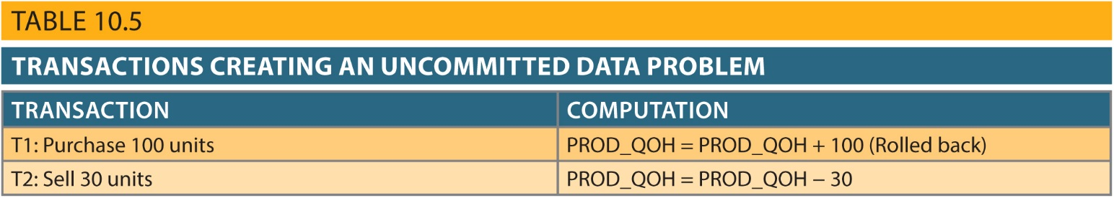
Uncommitted Data
Copyright © 2017 Cengage Learning
7

Slide 8
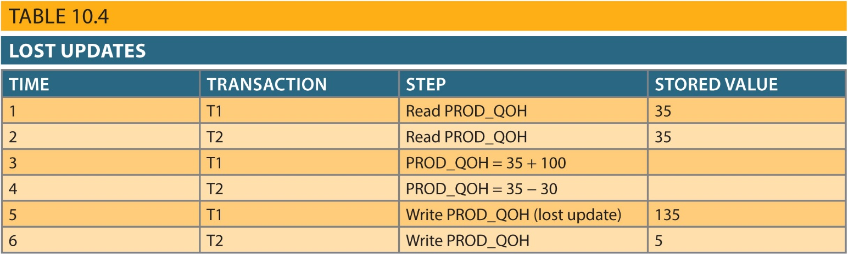
Lost Updates
Copyright © 2017 Cengage Learning
8

Slide 9
Inconsistent Retrievals
Inconsistent retrievals:
First transaction accesses data
Second transaction alters the data
First transaction accesses the data again
Transaction might read some data before they are changed and other data after changed
Yields inconsistent results
Copyright © 2017 Cengage Learning
9

Slide 10
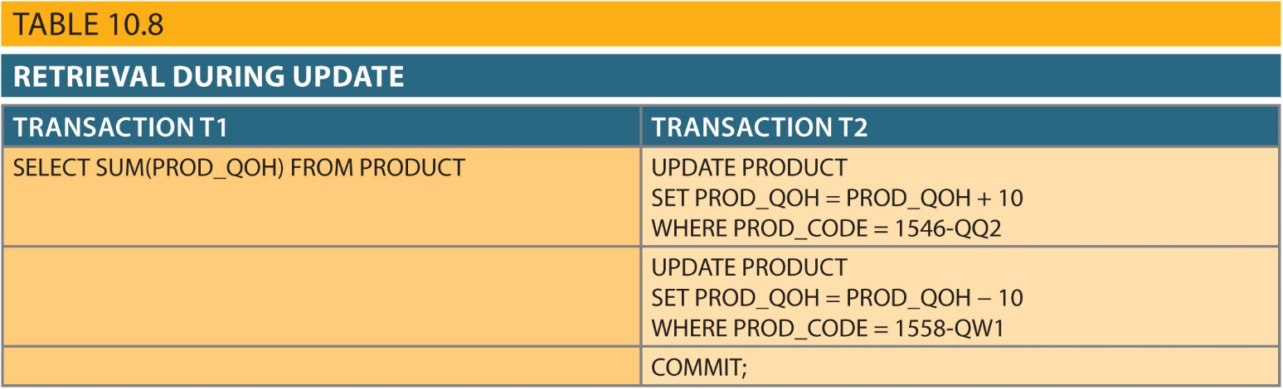
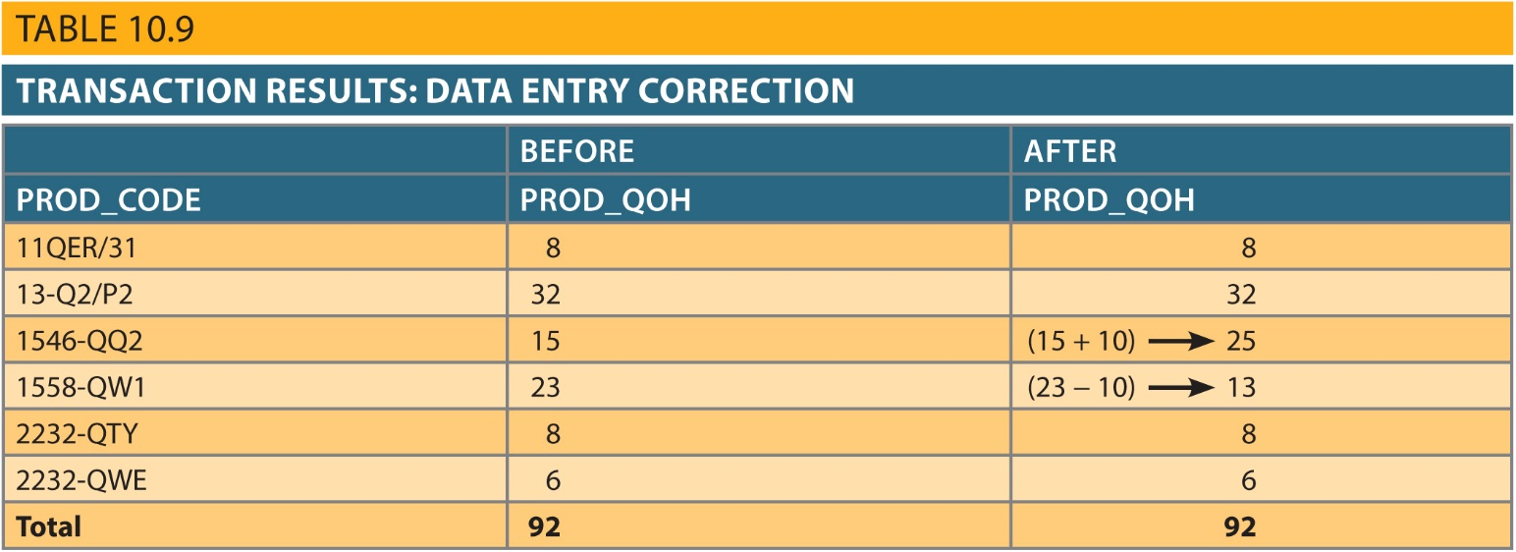
Inconsistent Retrievals
Copyright © 2017 Cengage Learning
10

Slide 11
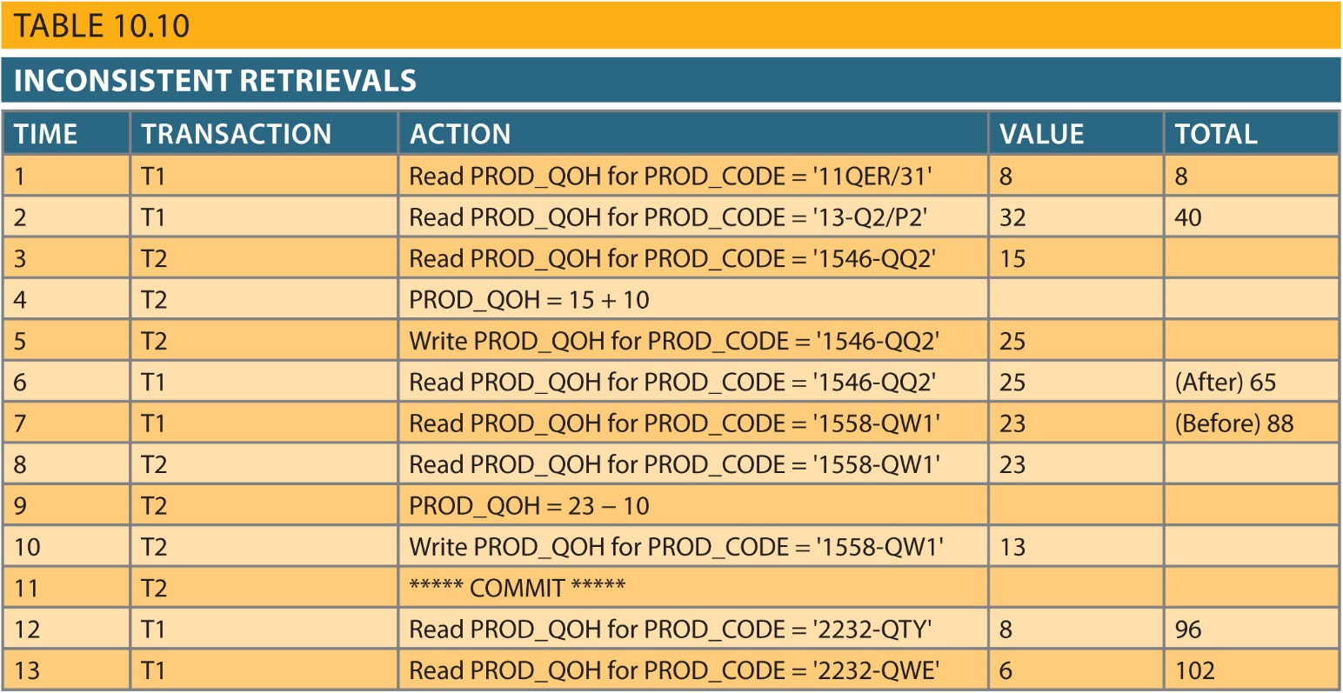
Inconsistent Retrievals
Copyright © 2017 Cengage Learning
11

Slide 12
The Scheduler
Establishes the order in which the operations are executed within concurrent transactions
Interleaves the execution of database operations to ensure serializability and isolation of transactions
Based on concurrent control algorithms to determine the appropriate order
Creates serialization schedule
Serializable schedule: Interleaved execution of transactions yields the same results as the serial execution of the transactions
Copyright © 2017 Cengage Learning
12

Slide 13
Concurrency Control with Locking Methods
Locking methods - Facilitate isolation of data items used in concurrently executing transactions
Lock: Guarantees exclusive use of a data item to a current transaction
Pessimistic locking: Use of locks based on the assumption that conflict between transactions is likely
Lock manager: Responsible for assigning and policing the locks used by the transactions
Copyright © 2017 Cengage Learning
13

Slide 14
Lock Granularity
Indicates the level of lock use
Levels of locking
Database-level lock
Table-level lock
Page-level lock
Page or diskpage: Directly addressable section of a disk
Row-level lock
Field-level lock
Copyright © 2017 Cengage Learning
14

Slide 15
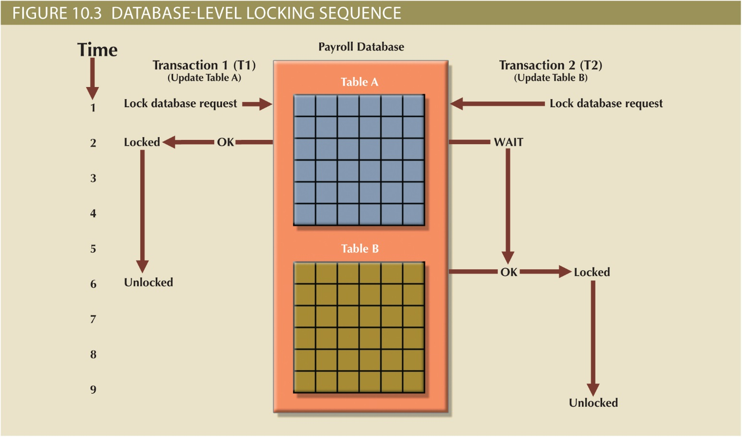
Figure 10.3 - Database-Level Locking Sequence
Copyright © 2017 Cengage Learning
15

Slide 16
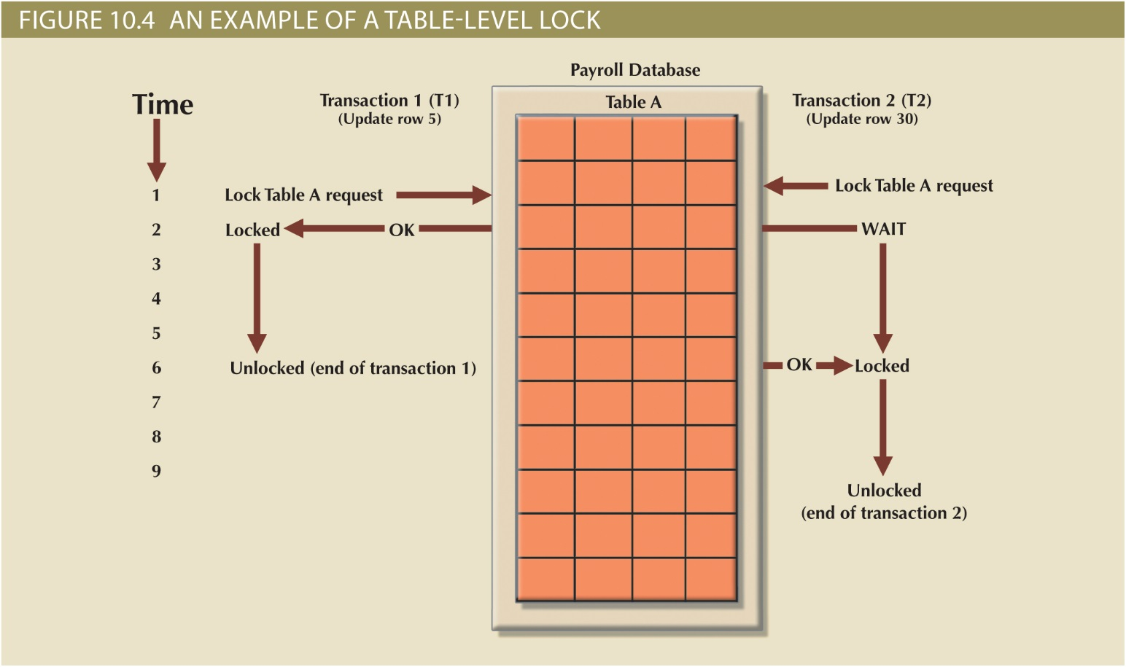
Figure 10.4 - An Example of a Table-Level Lock
Copyright © 2017 Cengage Learning
16

Slide 17
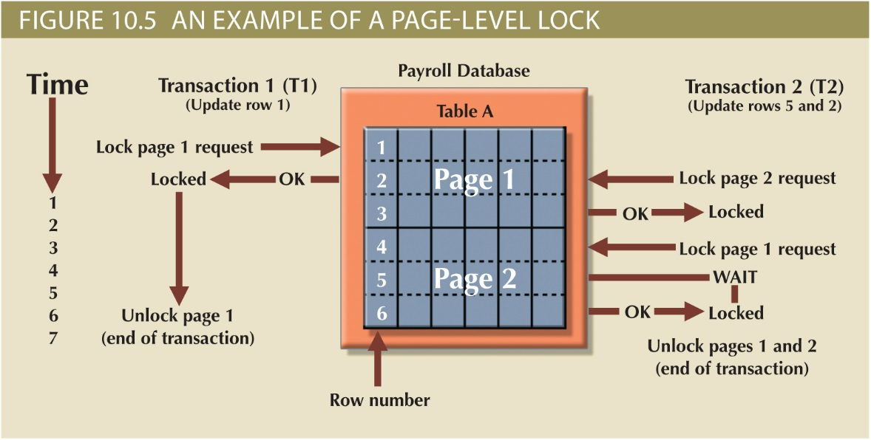
Figure 10.5 - An Example of a Page-Level Lock
Copyright © 2017 Cengage Learning
17

Slide 18
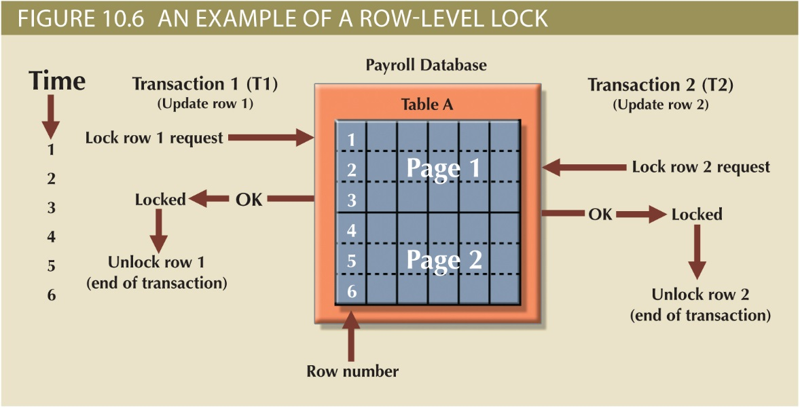
Figure 10.6 - An Example of a Row-Level Lock
Copyright © 2017 Cengage Learning
18

Slide 19
Lock Types
Binary lock
Has two states, locked (1) and unlocked (0)
Exclusive lock
Exists when access is reserved for the transaction that locked the object
Shared lock
Exists when concurrent transactions are granted read access on the basis of a common lock
If an object is locked by a transaction, no other transaction can use that object
If an object is unlocked, any transaction can lock the object for its use
Copyright © 2017 Cengage Learning
19

Slide 20
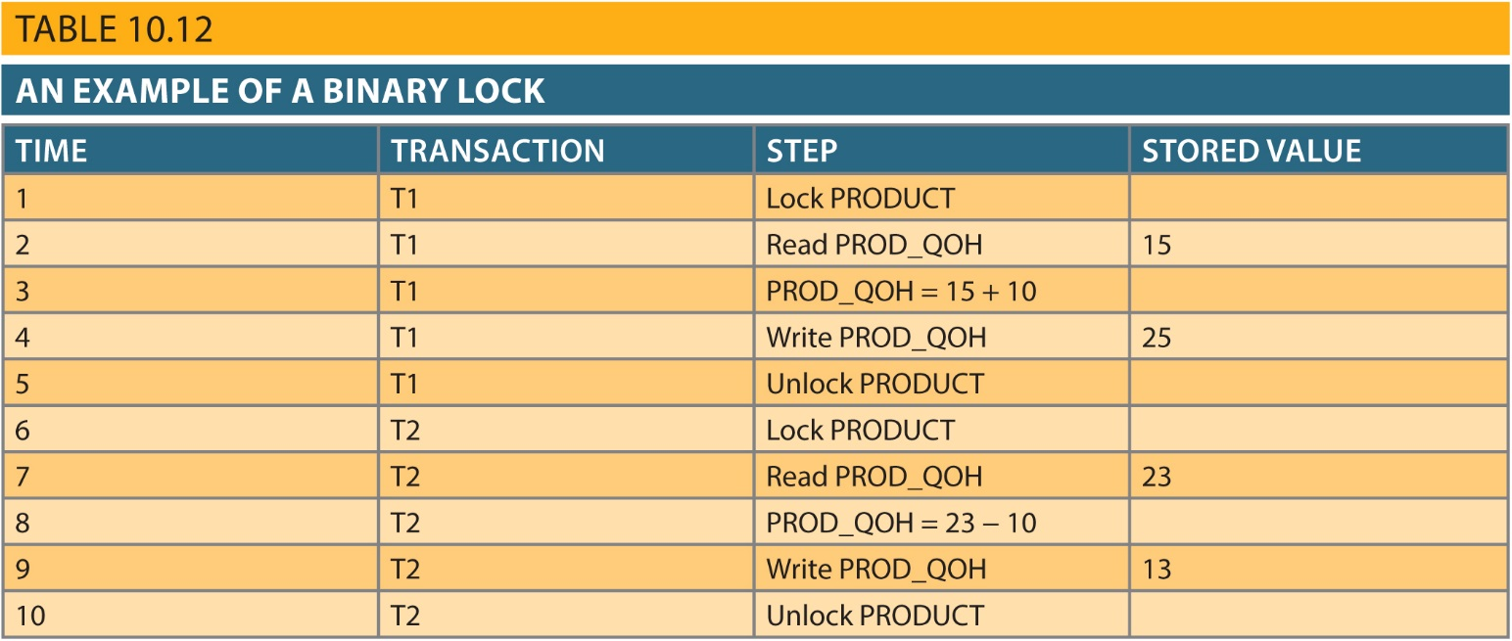
Binary Lock
Copyright © 2017 Cengage Learning
20

Slide 21
Summary
Concurrency control coordinates simultaneous execution of transactions
Scheduler establishes order in which concurrent transaction operations are executed
Lock guarantees unique access to a data item by transaction
Two types of locks: binary locks and shared/exclusive locks
Copyright © 2017 Cengage Learning
21

Slide 22
Task
Describe why a DBMS using row level locking should perform faster than a DBMS that uses table level locking.
Copyright © 2017 Cengage Learning
22

